Slide 1
Subsea Services Inc.
Website Development
Round 3 Comments
15 Sep 2016

Slide 2
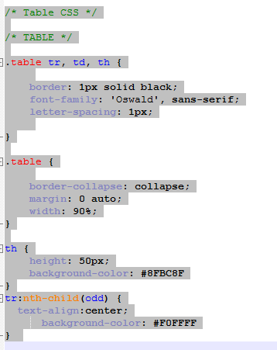
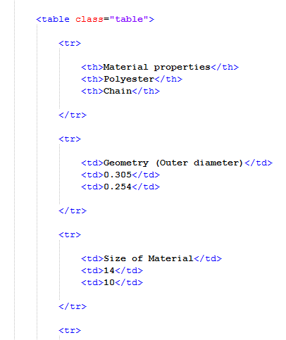
Table’s in Web report
In the web report the tables added from the below location:
Dropbox\0119 Programming\Cal\017-0023-01 Report Tables.xlsx
CSS CODE:

Slide 3
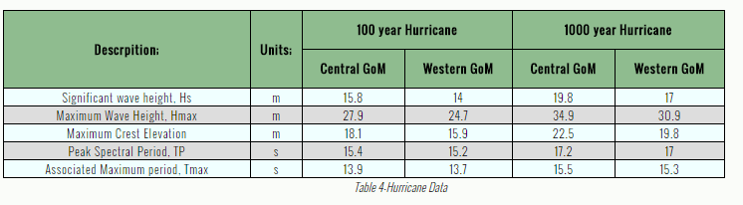
Table’s in Web report (VA Comment1)
The tables are looking beautiful. Lots of formatting happening.
A single heading is displayed for 2 columns in a custom manner using column span =2. Very Good!
Corrections:
Make the Table title : Bold, Relatively bigger font than table header row font
Decrease the row height for the tables (if possible) so it looks more slim/sleek

Slide 4
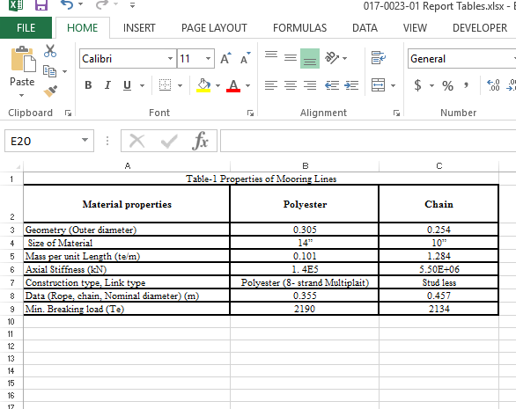
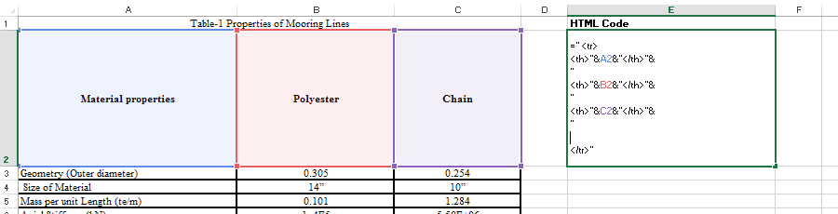
Table’s in Web report (VA Comment1)
Code Comment
For next web report, we should save each table as .csv file shown in screenshot on right.
We should write a small program in report that will convert the .csv files into HTML code directly without any user intervention.
I wrote some code in Excel but we should do this in javascript (Maiku to recommend)

Slide 5
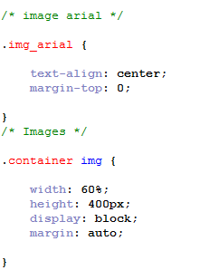
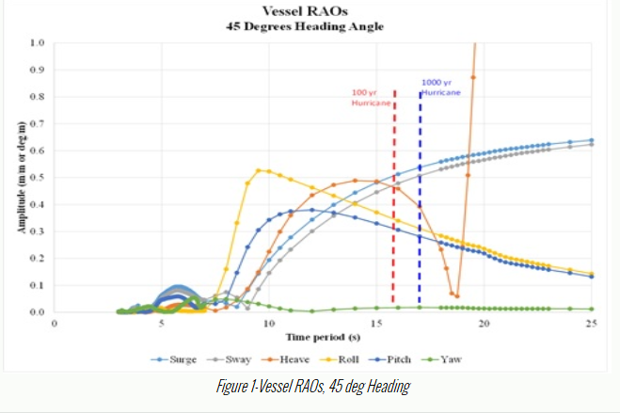
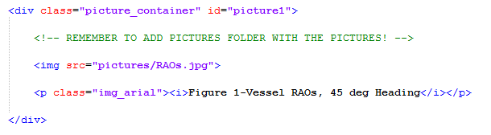
Pictures in Web report (VA comments1)
In the web report the pictures added with help of below code:
The picture size aspect ratio should not be changed at all unless the user wants to. Else the pictures saved should be displayed as is.
Also, this picture quality is very poor. Please try to get good quality. Write a guideline on how to do this in Web Report Manual.

Slide 6
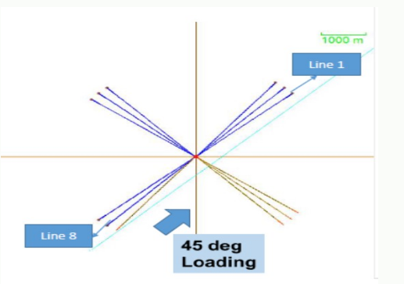
Pictures in Web report (VA comments2)
An example of where picture size aspect ratio should not be changed. Else it looks ugly.

Slide 7
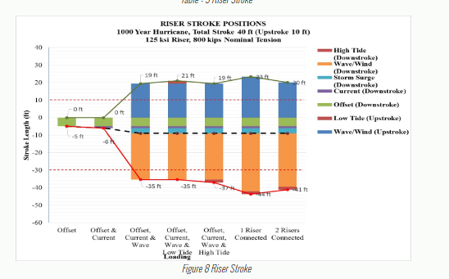
Pictures in Web report (VA comments3)
1/ Ability to click on picture and make it appear on entire screen. If they click on outside, it should again disappear.
2/ If we save this picture in high quality, the user can easily read numbers from this picture.

Slide 8
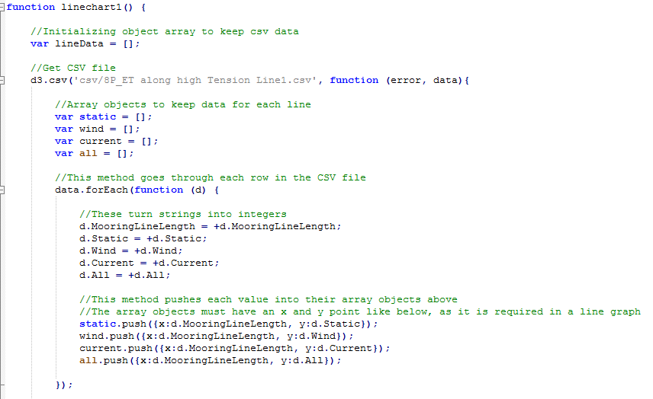
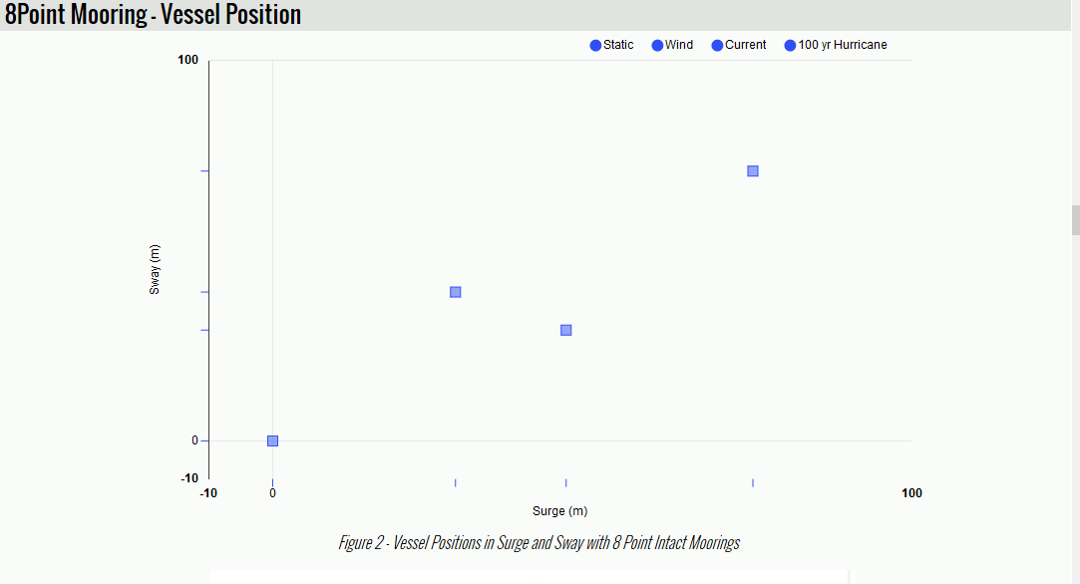
CSV in Web report
In the web report the CSV files added with using js script
This is great automation. The .csv file used looks very simple and good.
A bit more improvements:
1/ User should be able to edit the x-axis and y-axis range if required
2/ Figure title should be made larger than plot labels.
3/ Ability to include line or marker or both in a line graph.

Slide 9
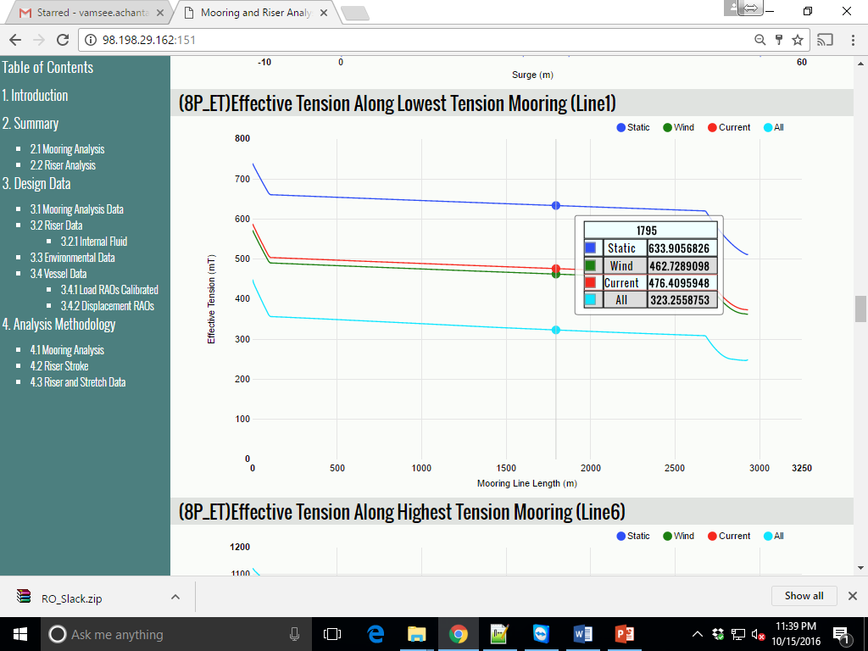
Value Display – NO of decimals
Too many decimal points. We should be able to round this
or use an algorithm to round to 0.1% accuracy.
Also, the format scientific vs. decimal should be flexible.

Slide 10
High Level Plan
Suggest we maintain 1 HTML file for each section.
i.e. we will have 10 files for 10 sections.
This will help easily manage and edit files
Code wise we may use iframes? (http://stackoverflow.com/questions/20868304/insert-one-html-file-into-another-html-file)
Tables and figures should be individual files
The Table of Contents should be automatically generated
By frisking through HTML files for Sections, Tables and Figures
Containers and subcontainers should also be automatically generated by looking in HTML files
Any other improvements to help things further.
This is great automation. The .csv file used looks very simple and good.
A bit more improvements:
1/ User should be able to edit the x-axis and y-axis range if required
2/ Figure title should be made larger than plot labels.
3/ Ability to include line or marker or both in a line graph.

Slide 11
THANK YOU
For the opportunity to serve!

Slide 12
Document Revision History
01 | Round 2 comments. Round 1 comments in PRE-0006-01 | 12 Sept 2016 |  | GSY | VA
Rev | Description | Date |  | Author | Checked | Approved
Document No: |  |  | Client Ref:
0119-PRE-0007-01 |  |  | n/a

